Slide 1
Chapter 10 Notes
Section 3

Slide 2
Seed Reproduction
The Importance of Pollen and Seeds
In seed plants, some spores develop into small structures called pollen grains.
Pollen grain- small structures, developed from spores, that have a water-resistant covering and contains gametophyte parts that can produce sperm.
Pollination- transfer of pollen grains to the female part of the plant

Slide 3
Seeds
A seed consist of an embryo, stored food, and a protective seed coat.
Gymnosperms and angiosperms are seed plants.
In gymnosperms, seeds usually develop in cones.
In angiosperms, seeds develop in the flowers and the fruit.

Slide 4
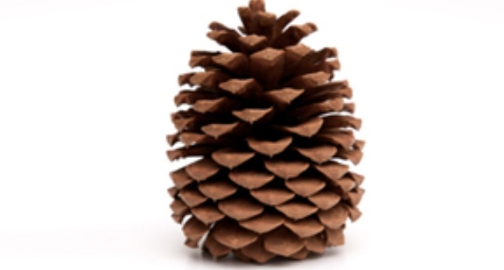
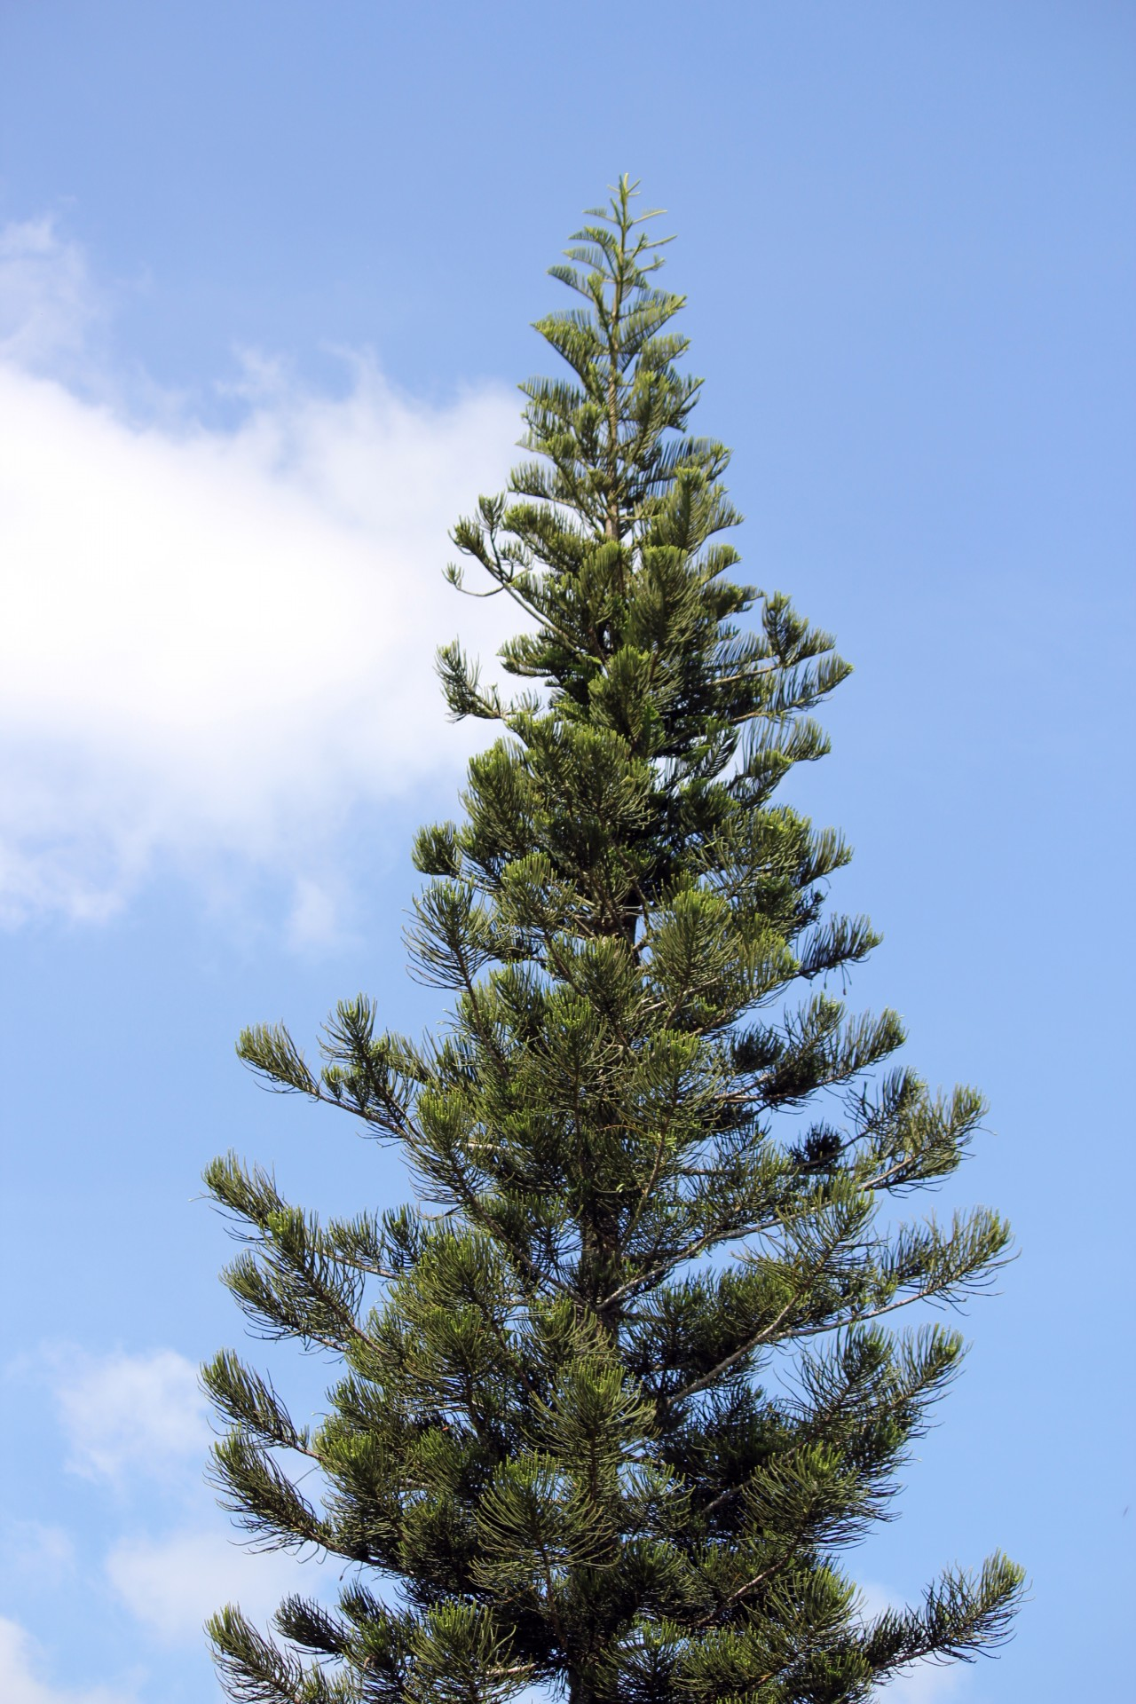
Gymnosperm Reproduction
The pine is an example of a familiar gymnosperm.
Ovule- where the eggs are produced in the plant.
Pollen is carried from male cones to the female cones by the wind.

Slide 5
Angiosperm Reproduction
All angiosperms have flowers.
Most flowers have four main parts: petals, sepals, stamen, and pistil.
The petals are the colorful parts, outside the petals are the leaf-like sepals.
Stamen- male reproductive organ where pollen is produced.
-pistil- female reproductive organ.
Ovary- swollen base of the pistil where ovules are found.

Slide 6
Seed Dispersal and Germination
Pollen from flowers is spread by animals, wind, rain, or gravity.
A flower is pollinated when pollen grains land on the sticky stigma.
In the seeds of some plants, like beans and peanuts, the food is stored in structures called cotyledons. Plants like corn and wheat have food stored in a tissue called an Endosperm.
Germination- series of events that results in the growth of a plant from a seed.
Germination is affected by temperature, sunlight, water, and the amount of oxygen present.

Slide 7
End of Chapter 10

