Slide 1
Chapter 12
Section 2: Sponges and Cnidarians

Slide 2
Sponges
Sessile- organisms that remain attached to one place during their lifetime. (Ex. Sponge.)
Groups of sponges are called colonies.
Sponges are classified as animals because they cannot make their own food.
Spicules- sharp, pointed structures on many sponge bodies.
Hermaphrodites- animals that produce sperm and eggs in the same body (sponge’s sperm cannot fertilize its own egg.)
Sponges also reproduce asexually by budding and regeneration.

Slide 3
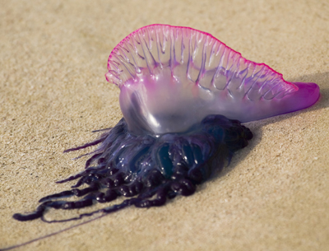
Cnidarians
Cnidarians- group of invertebrates that includes colorful corals, sea anemones, hydras, jellyfish and the iridescent Portuguese man-of-war.
Cnidarians have 2 different body forms the polyp and the medusa.
Polyp- is shaped like a vase and is usually sessile.
Medusa- are bell-shaped and are free swimming.

Slide 4
Body Structure of a Cnidarian
Tentacles- arm-like structures that surround the mouths of most cnidarians.
Stinging Cell- a capsule with a coiled, threadlike structure that helps the cnidarian capture food.
Coral reefs are found in shallow tropical seas where one generation of corals secretes their hard external skeleton on those earlier generations.

Slide 5
End of Section 2

