Slide 1
Chapter 12
Section 3: Flatworms and Roundworms

Slide 2
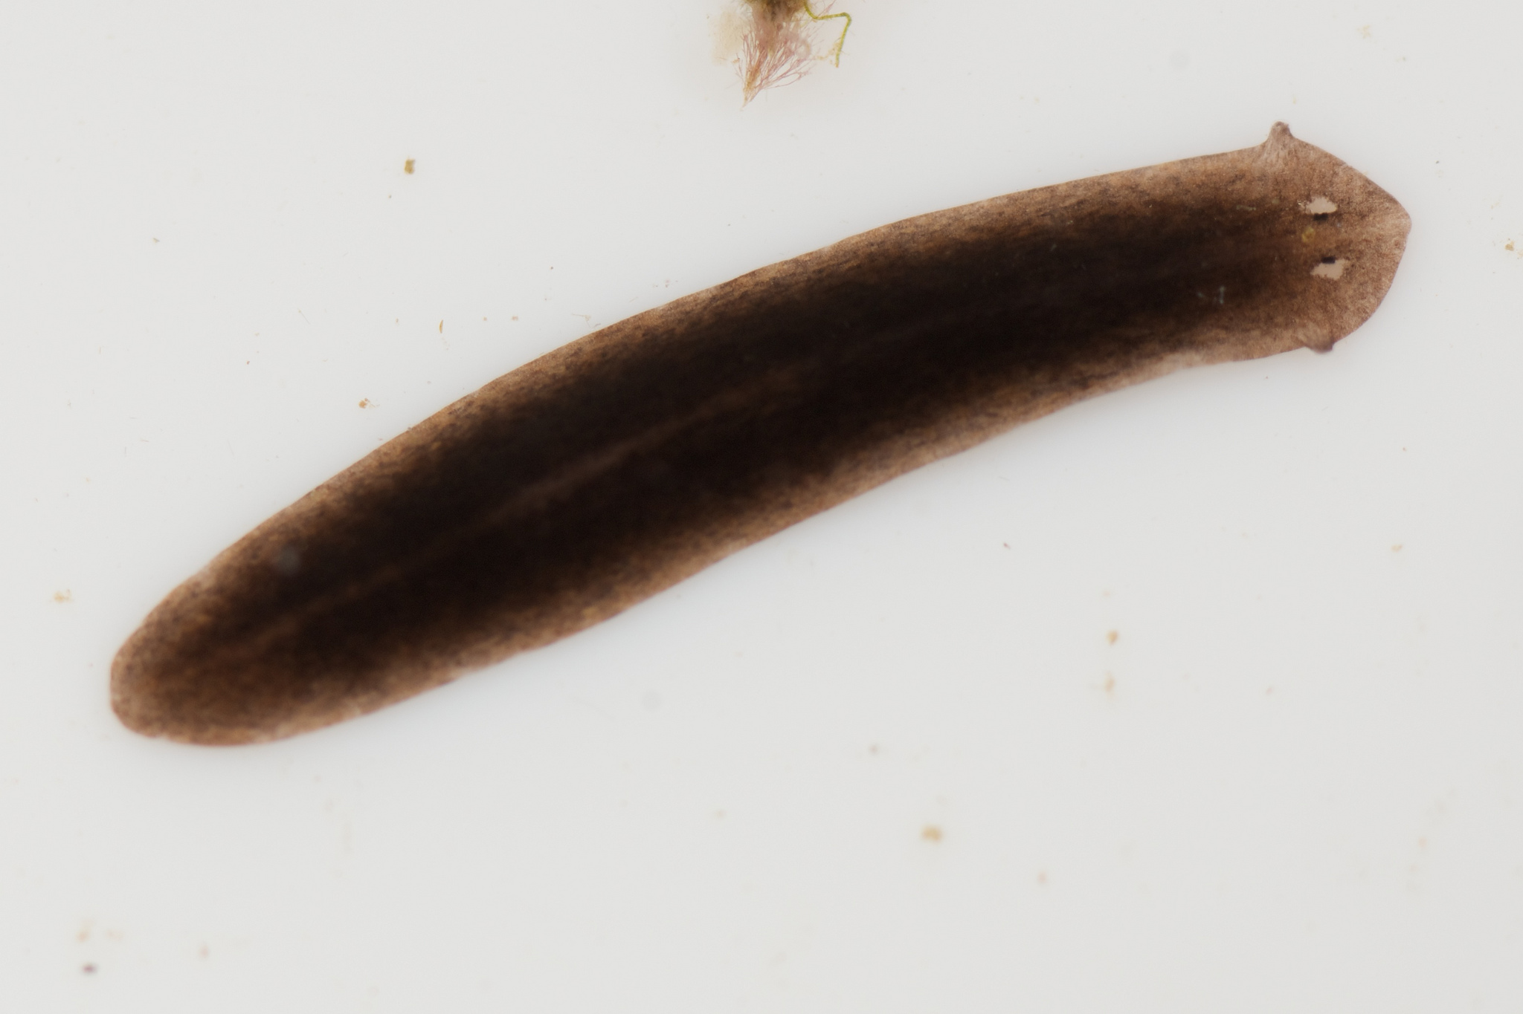
Flatworms
Worms are invertebrates with soft bodies and bilateral symmetry
Flatworms are parasites ( depend on another organism for food and a place to live)
Free-living organism- organism that do not depend on another organism for food and a place to live.
Flukes are flatworms that live in the blood and kill over 1 million people per year.
A tapeworm is a flatworm that lives in the host’s intestine and absorbs food digested by the host. They can grow to be 12 meters long (36feet).

Slide 3
Roundworms
Roundworms are slender and tapered at both ends; also called nematodes.
Heartworms in dogs are a type of roundworm.
Anus- opening at the end of the digestive tract through which wastes leave the body.

Slide 4
End of Section 3

