Slide 1
Chapter 14 Notes
Fish, Amphibians, and Reptiles

Slide 3
Section 1: Chordates and Vertebrates
Chordates are animals that have four characteristics present at some stage of their development.
Chordates- animals that have a notochord, postanal tail, nerve chord, and pharyngeal pouches.
Notochord- is flexible but firm structure that extends along the upper body and supports the animal. ( Some chordates; fish, amphibians, reptiles, birds, mammals, develop backbones that replace the notochord.)

Slide 4
Chordates
Postanal tail- muscular structure at the end of the developing chordate.
Above the notochord and along the length of a developing chordates body is the nerve chord.
Nerve chord- tube-like structure that enlarges to form the brain and spinal chord.
All developing chordates have pharyngeal pouches.
Pharyngeal pouches- pairs of openings between the mouth and digestive tube. ( In fish they develop into gills; in humans they become the tubes that go from the ears to the throat.)

Slide 5
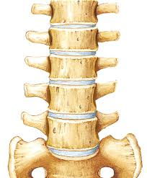
Characteristics of a Vertebrate
Vertebrates are animals with a backbone.
All vertebrates have an endoskeleton.
Endoskeleton- internal framework that provides a place for muscles to attach and it supports and protects the body.
Cartilage- flexible tissue that makes up the ears, tip of the nose and disks between vertebra.
Cartilage
Vertebra

Slide 6
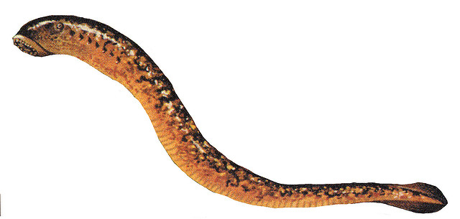
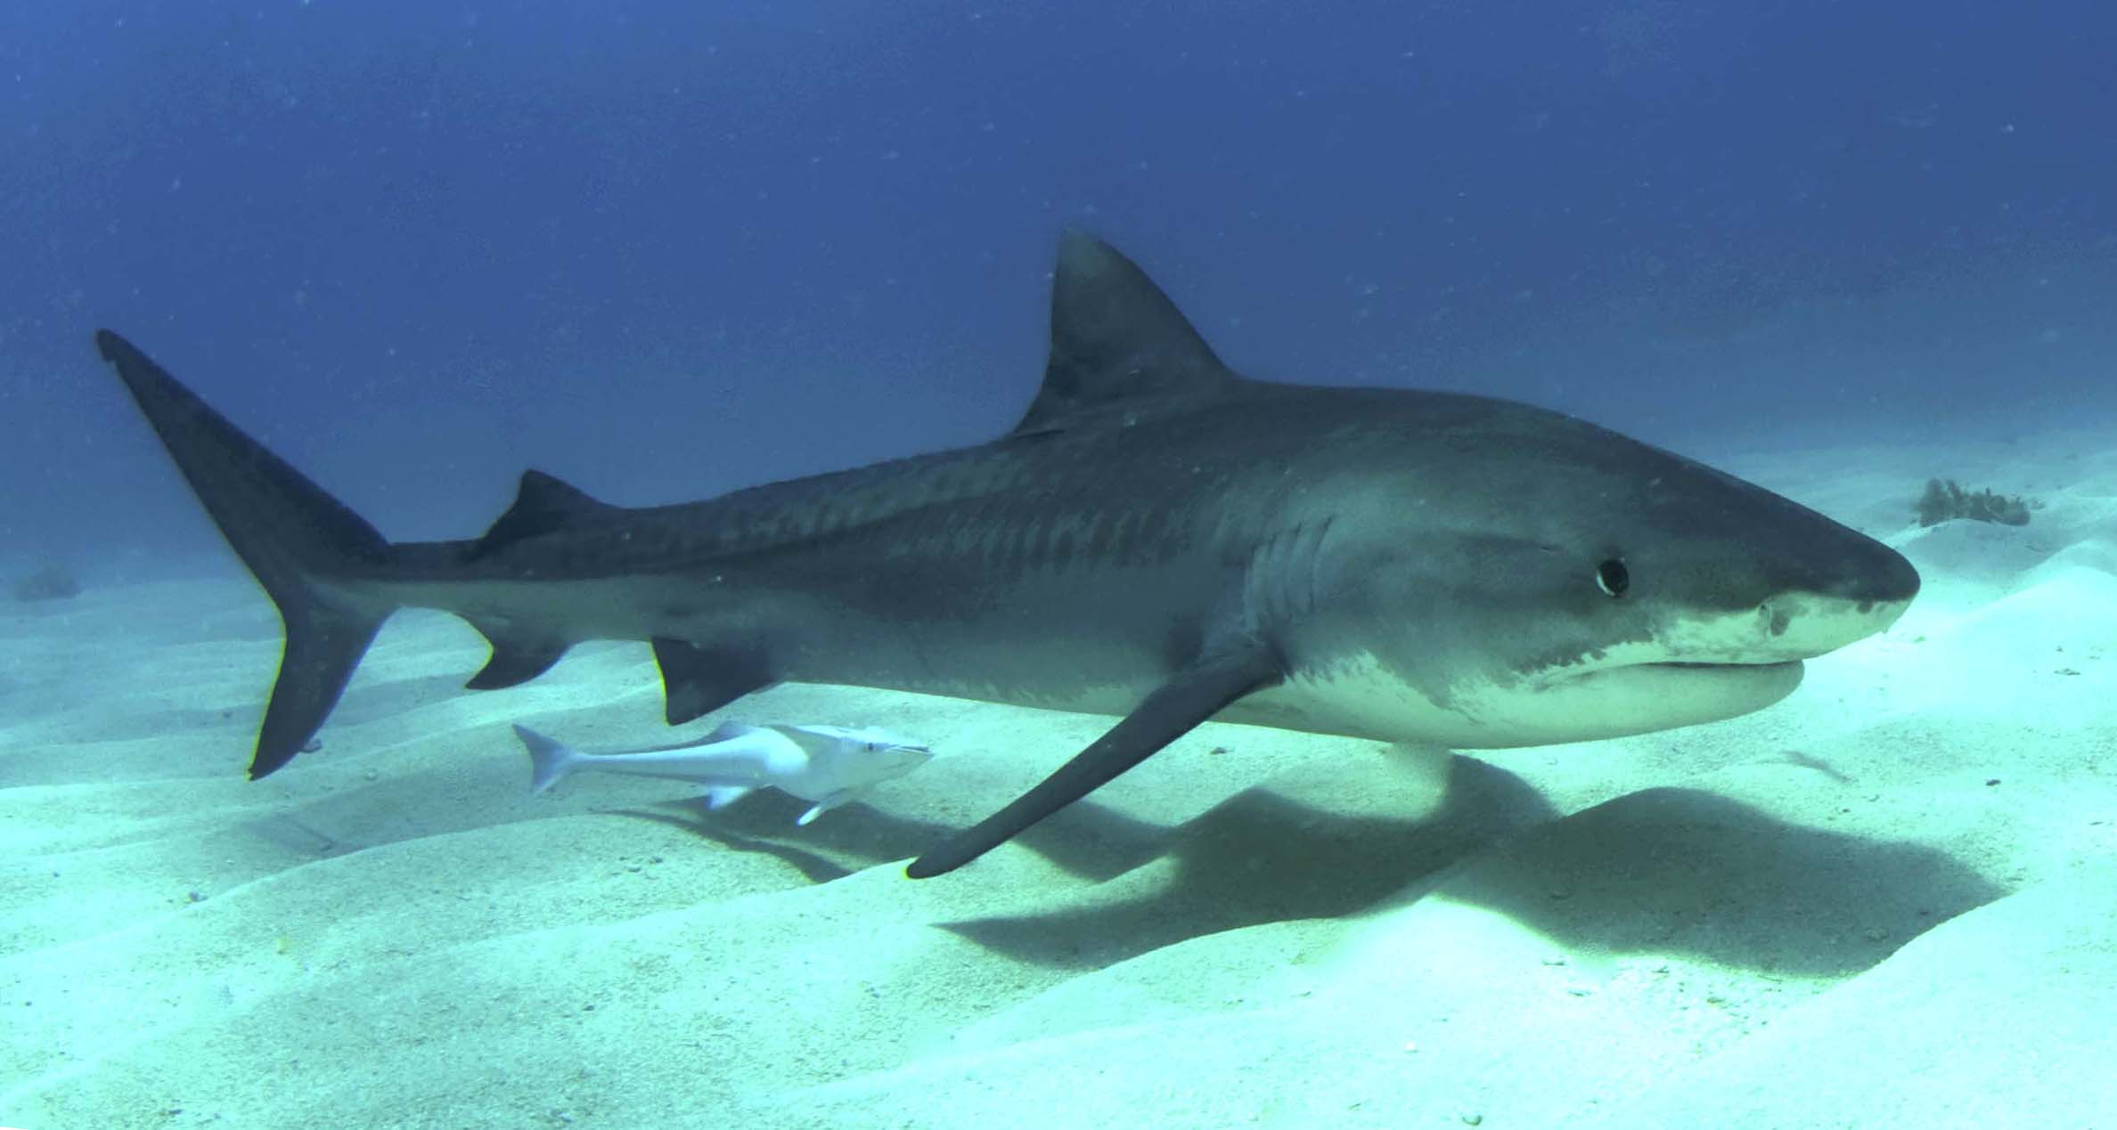
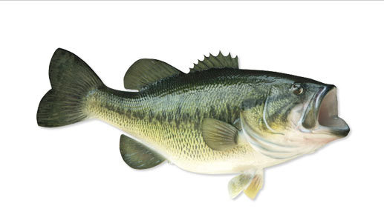
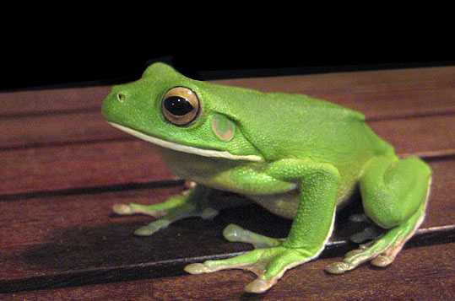
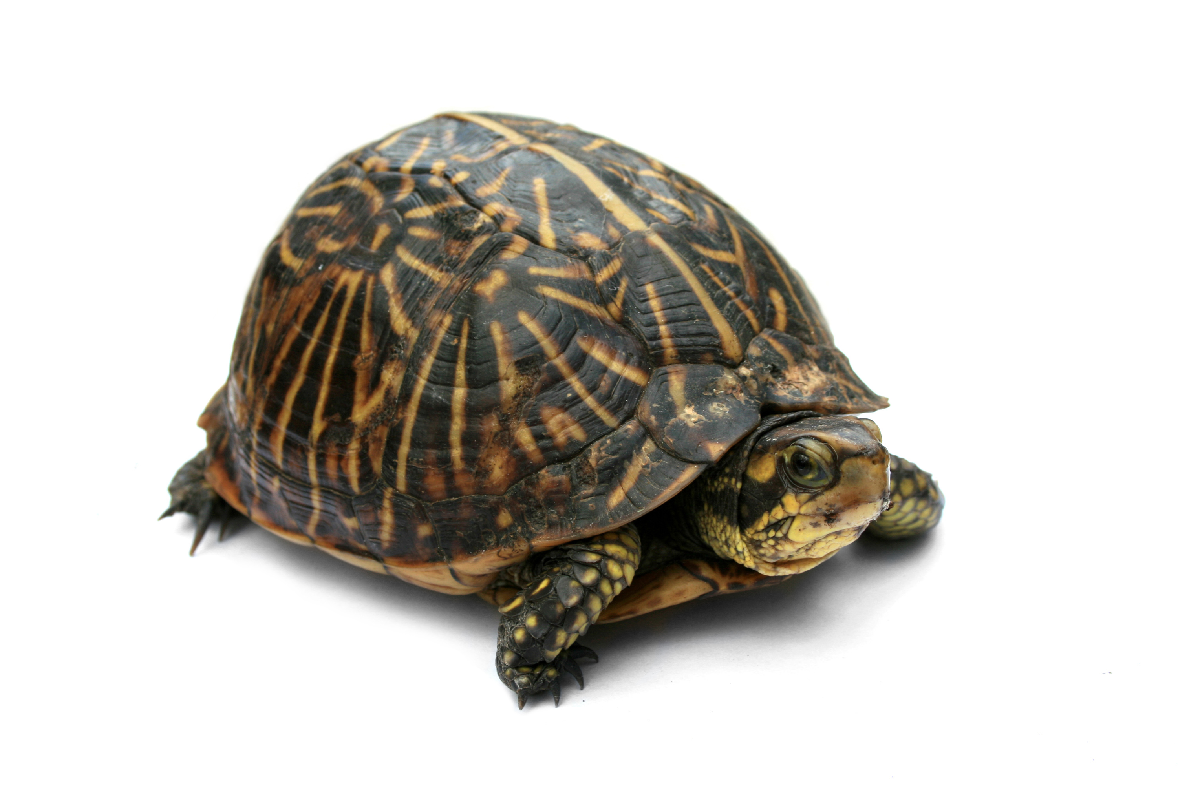
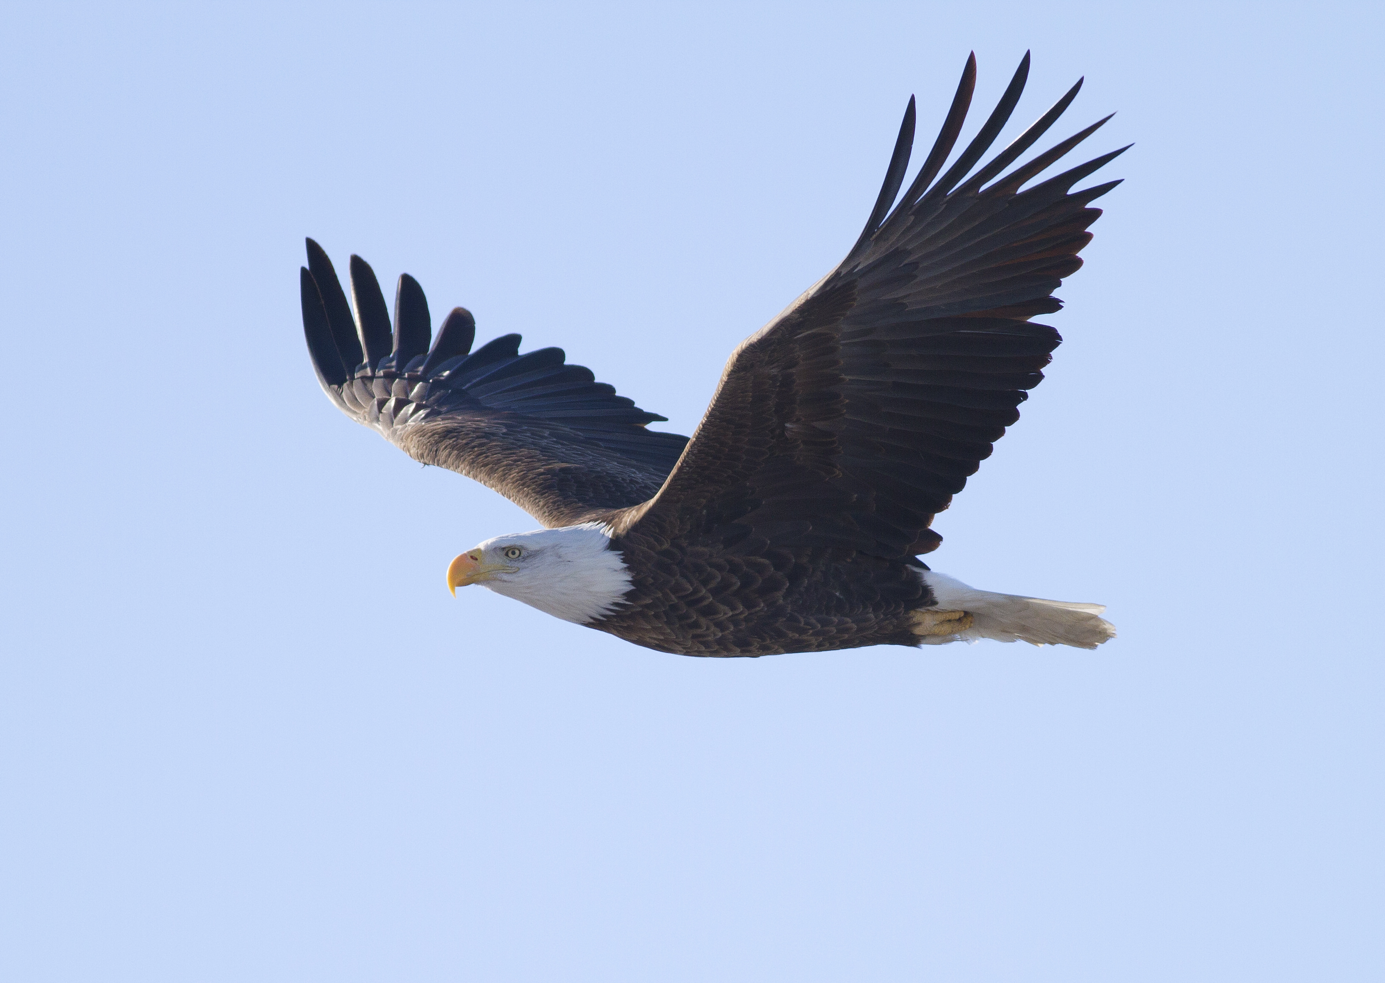
Characteristics of a Vertebrate
Group | Estimated # of Species | Examples | Photo
Jawless Fish | 60 | Lamprey, hagfish
Jawed Cartilaginous fish | 500-900 | Shark or Ray
Bony fish | 20,000 | Salmon, Bass, or Guppy
Amphibians | 4,000 | Frog or Toad
Reptiles | 7,970 | Turtle, Snake
Birds | 8,700 | Stork or Eagle
Mammals | 4,600 | Human or whale
- Seven main groups of vertebrates are found on Earth today.

Slide 7
Characteristics of a Vertebrate
Vertebrates are either ectotherms or endotherms.
Ectotherms – ( cold-blooded) body temperature changes with the temperature of its surroundings.
Fish, Amphibians, and Reptiles are all ectotherms, also known as cold-blooded animals.
Endotherms- ( warm-blooded) are animals that maintain a constant body temperature.
Birds and mammals are endotherms or warm-blooded animals.

Slide 8
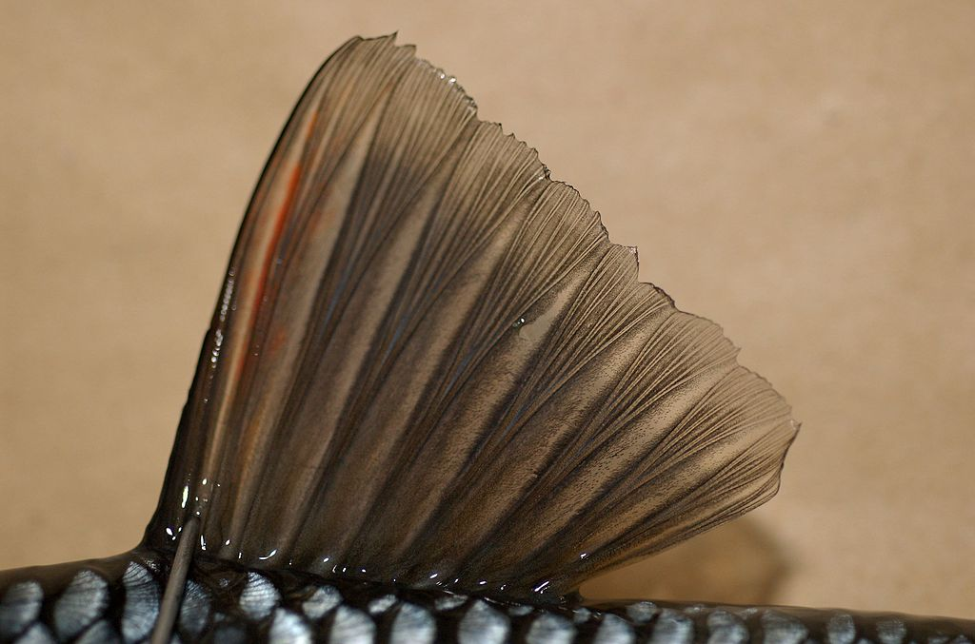
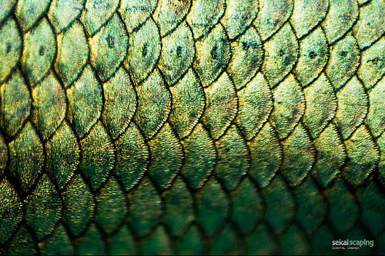
Section 2: Fish
There are more species of fish than any other vertebrate group.
Fish have a streamlined shape, muscular tail, and fins that allow most fish to move rapidly through the water.
Fins- fanlike structures attached to the endoskeleton ( used for steering, balancing, and moving.
Most fish have scales.
Scales- hard, thin plates that cover the skin and protect the body ( like shingles on a house).
Fins
Scales

Slide 9
Fish Characteristics
Most fish have a lateral line system ( it runs the length of the fish and is filled with sensory organs that enables a fish to sense the environment and detect movement.
Most fish have gills for the exchange of carbon dioxide and oxygen.
Fish reproduce sexually.
Reproduction is controlled by sex hormones that depend on temperature, length of daylight, and availability of food.

Slide 10
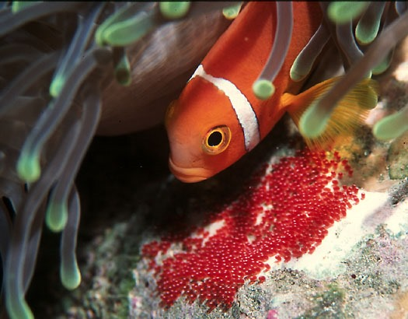
Fish Characteristics
Female fish release large numbers of eggs into the water.
The male fish swims over the eggs and releases sperm.
Fertilization outside the body is called external fertilization.

Slide 11
Fish Characteristics
There are 3 types of fish:
Jawless fish- they have round, toothed mouths and long tube-like bodies that are covered with slimy skin.
Jawed cartilaginous fish- they have a movable jaw, well developed teeth and tiny scales.
Bony fish- their skeletons are made of bone, they have a bony flap that covers their gills and they make up 95 percent of the fish population.
Most bony fish have a swim bladder ( an air sac that allows the fish to float at different levels in the water).

Slide 12
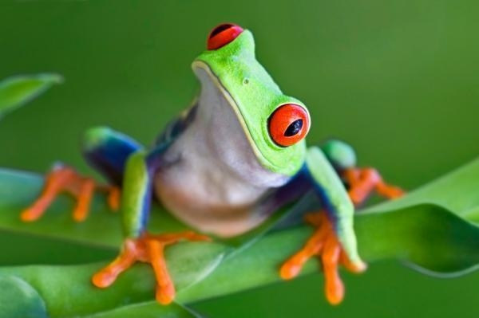
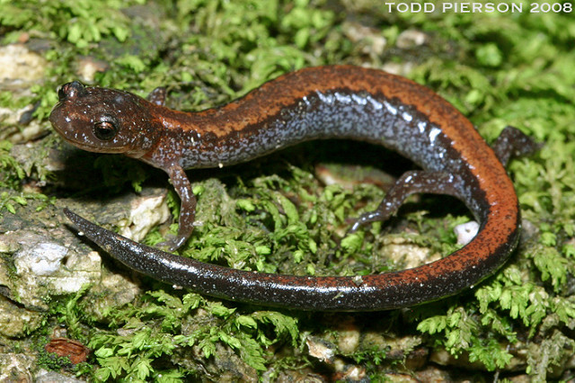
Section 3: Amphibians

Slide 13
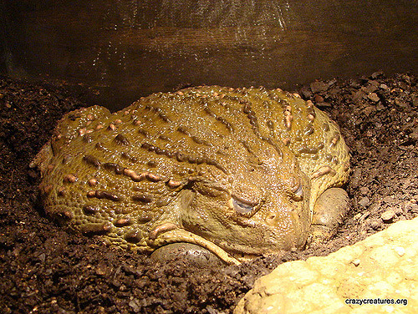
Section 3: Amphibians
Amphibian means “double life”. ( They spend part of their life on land and part of their life in water.
Amphibians are ectotherms (cold-blooded).
Amphibians become inactive in cold weather and bury themselves in mud or leaves until the temperature warms.
Hibernation- period of inactivity during cold weather.

Slide 14
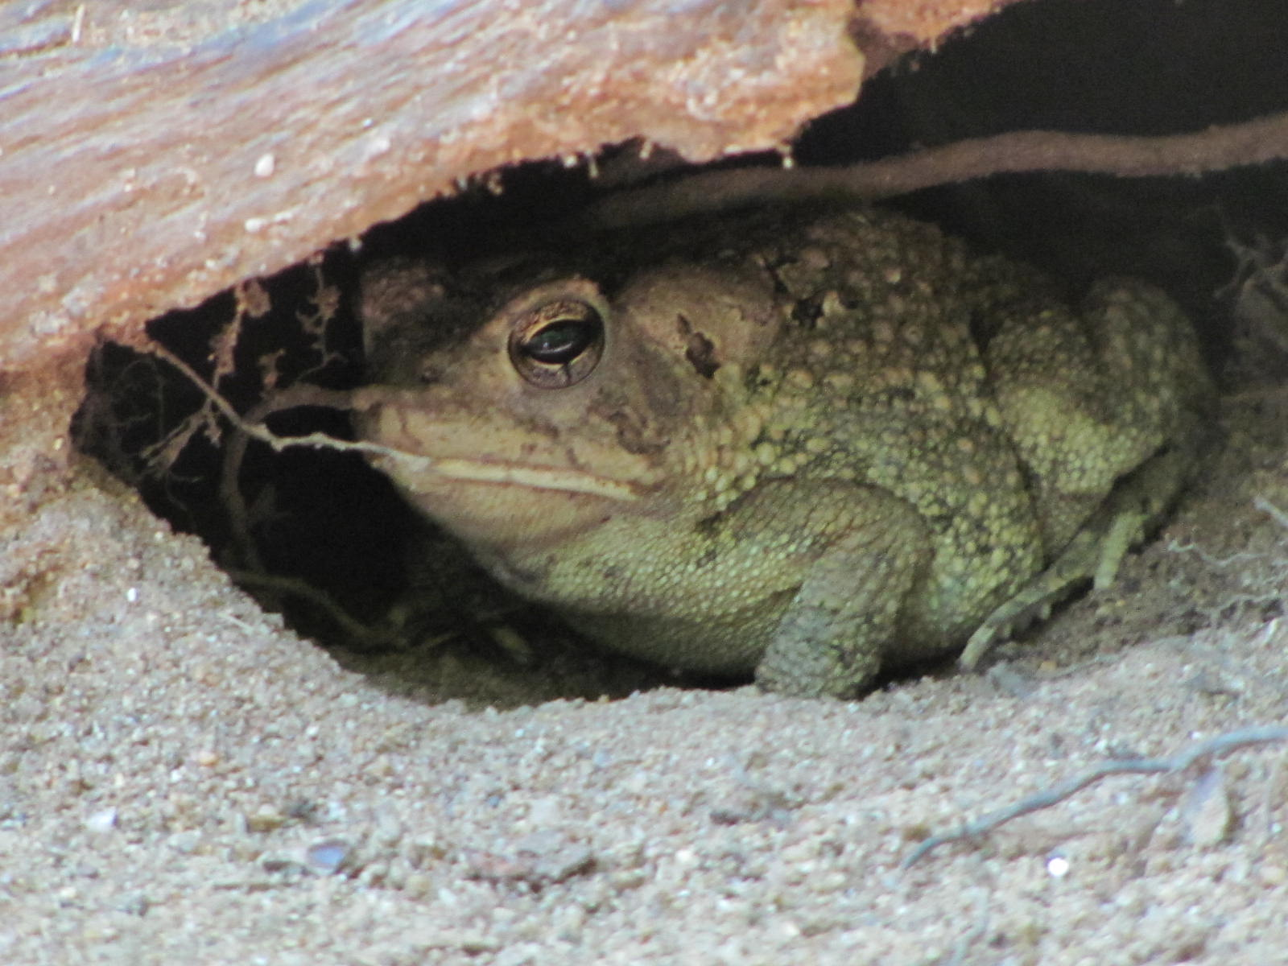
Section 3: Amphibians
Amphibians that live in hot, dry environments also become inactive and must hide in the ground when temperatures become to hot.
Estivation- is inactivity during the hot, dry months

Slide 15
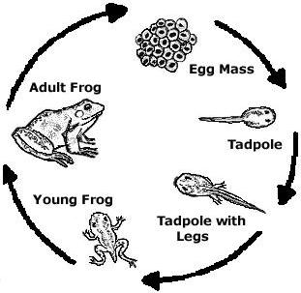
Amphibian Characteristics
Amphibians have moist skin, a three-chambered heart, dependent on water for reproduction, and go through a developmental process called metamorphosis.
Frogs have smooth, moist skin and have longer hind legs.
Toads have bumpy, dry skin and can exist in hot and dry climates.

Slide 16
Importance of Amphibians
Most adult amphibians are insect predators and are helpful in controlling some insect populations.
Amphibians are directly affected by the changes in the environment .
Biological indicator- species whose overall health reflects the health of a particular ecosystem.

Slide 17
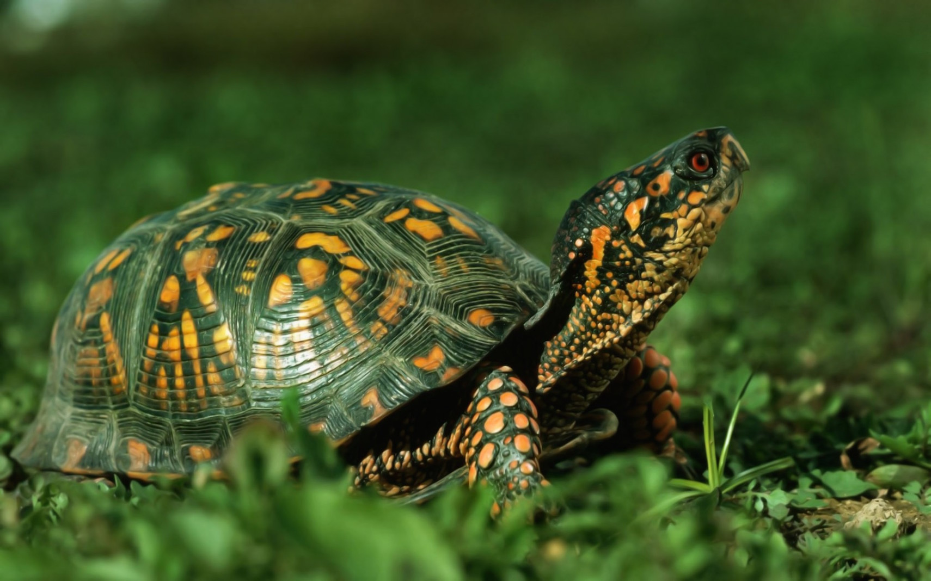
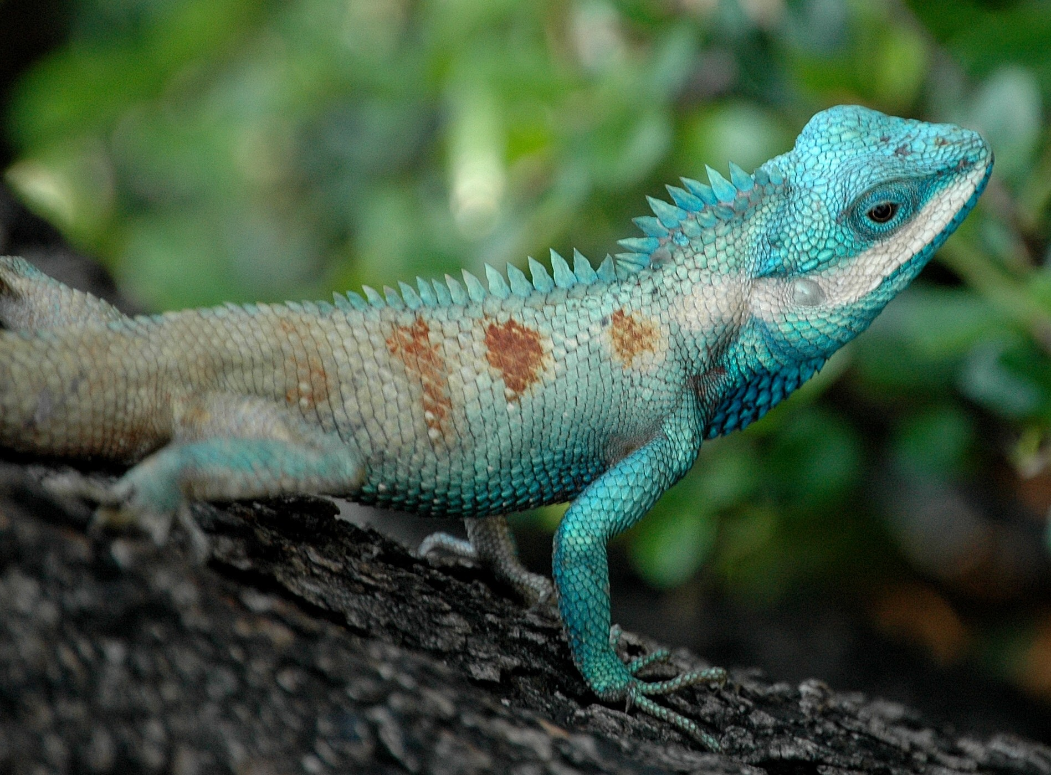
Section 4: Reptiles
Reptiles are ectotherms with a thick, dry, waterproof skin covered with scales.
Their jaw unhinges to increase the size of the mouth so they can eat larger prey.

Slide 18
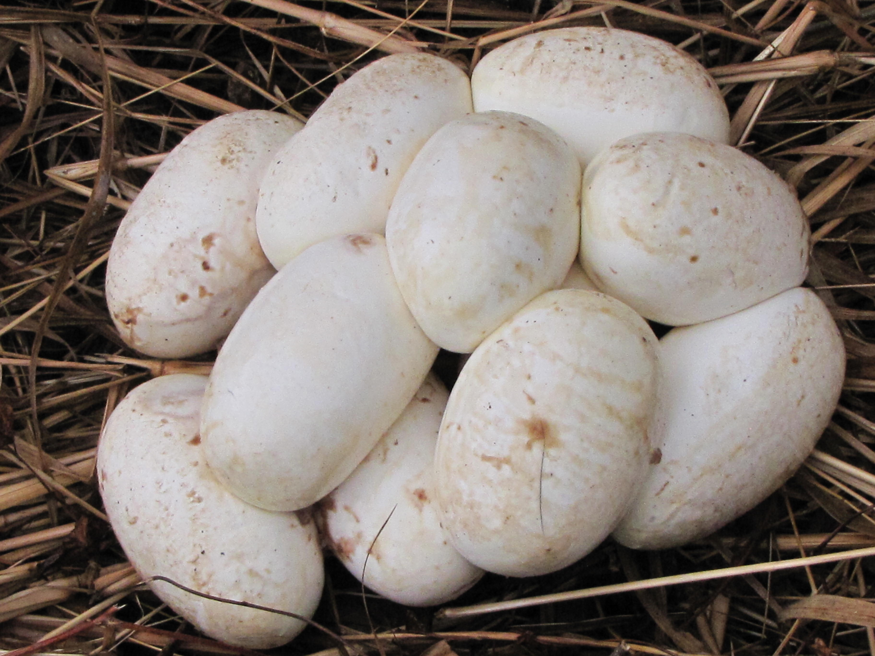
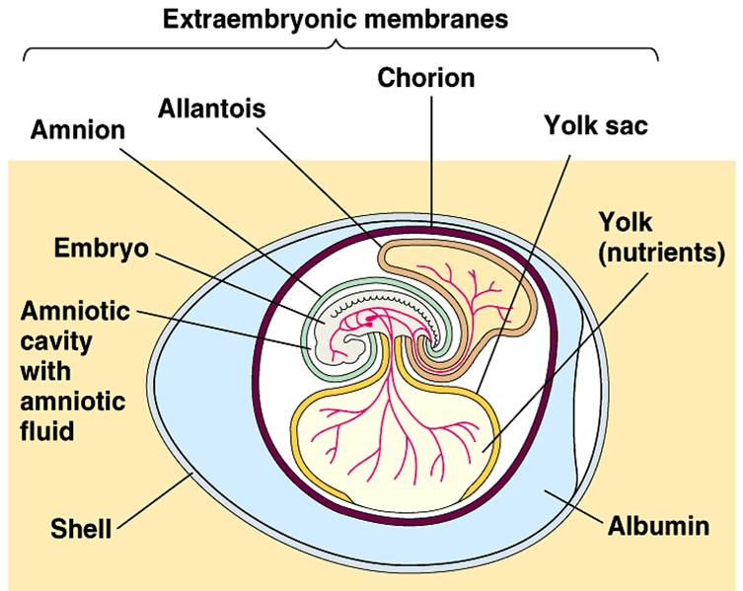
Reptile Reproduction
Eggs of reptiles are fertilized internally, covered with a tough shell and laid on land.
Amniotic egg- provides a complete environment for the embryo’s development ( tough covering, food supply).

Slide 19
Reptiles
The largest group of reptiles are the lizards and snakes.
Snakes have poor vision and eyesight; they depend on vibrations.
Crocodiles have a narrow head with a triangular snout and are very aggressive.
Alligators have a broad head with a rounded snout and are less aggressive.

Slide 20
The End

