Slide 1
Chapter 15 Notes
Birds and mammals

Slide 2
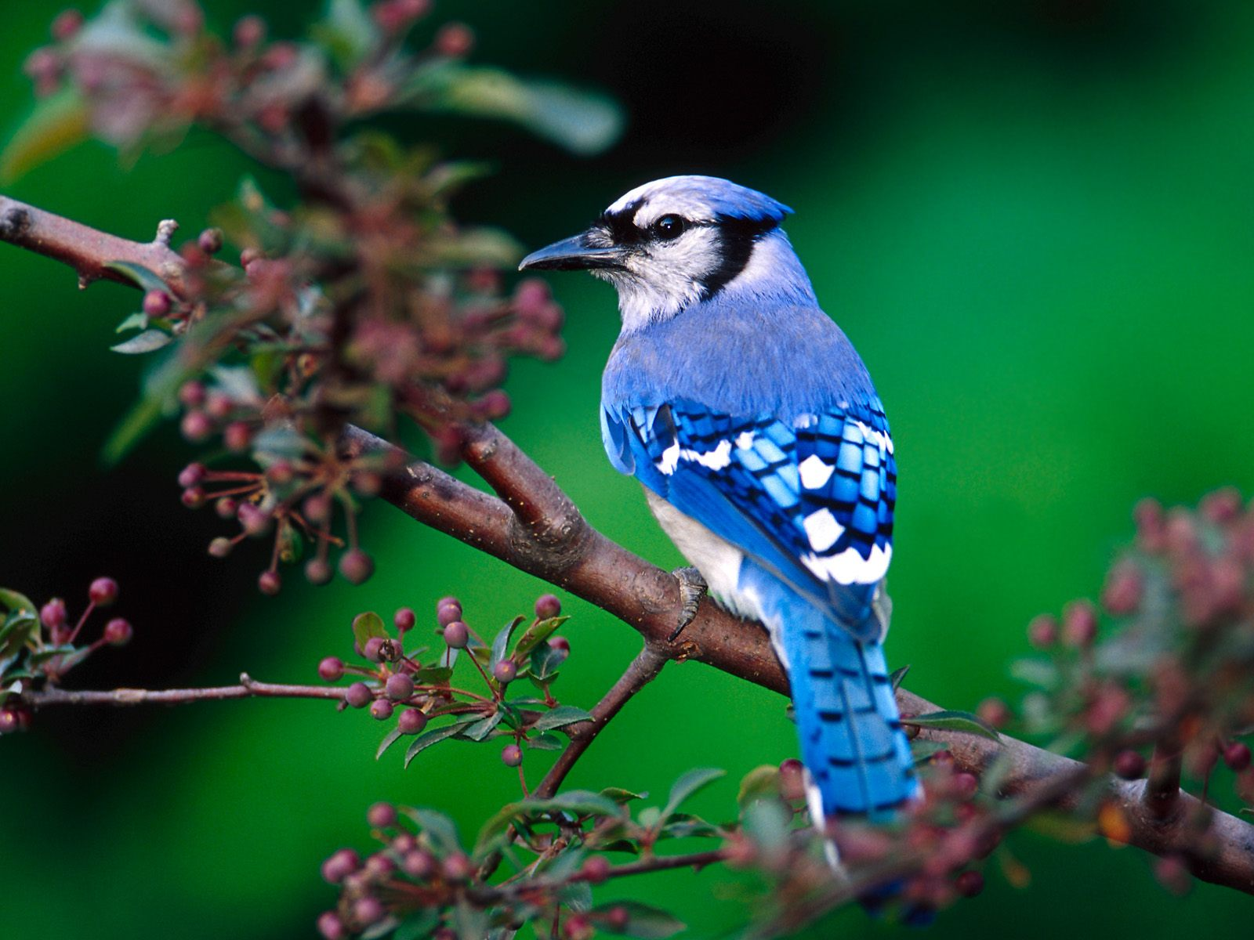
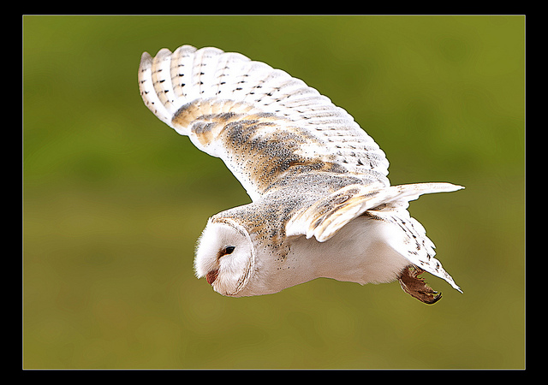
Bird Characteristics
Birds are very versatile animals.
Birds lay amniotic eggs that provide a moist, protective environment for the developing embryo.
A group of eggs is called a clutch.
Most bones in birds that fly are almost hollow with thin cross braces inside that also strengthen the bones. The hollow spaces are filled with air.

Slide 3
Bird Characteristics
Birds have two types of feathers, contour and down, and are the only animals with feathers.
Contour feathers- strong, lightweight feathers that give the bird coloring and smooth shape. The contour feathers on the wings and tail help the bird steer and help keep it in control.
Down feathers- soft, fluffy feathers that provide an insulating layer next to the skin.
Birds are endotherms.
Endotherms- birds maintain a constant body temperature.

Slide 4
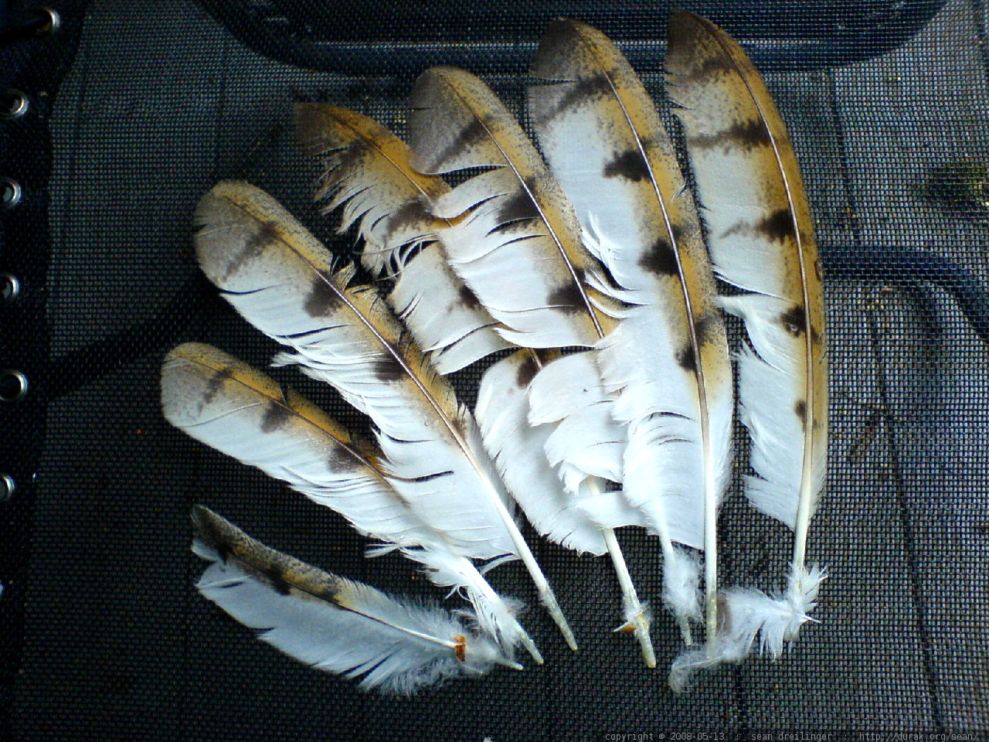
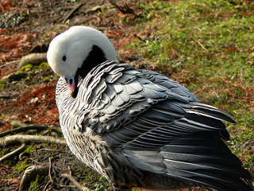
Bird Characteristics
Feathers grow from a pit in the skin called a follicle.
When a feather falls out, a new one grows in its place.
The shaft of a feather has many branches called barbs to give it strength.
Preening- process where a bird rubs oil from oil glands over its feathers to condition the feathers and help them last longer.

Slide 5
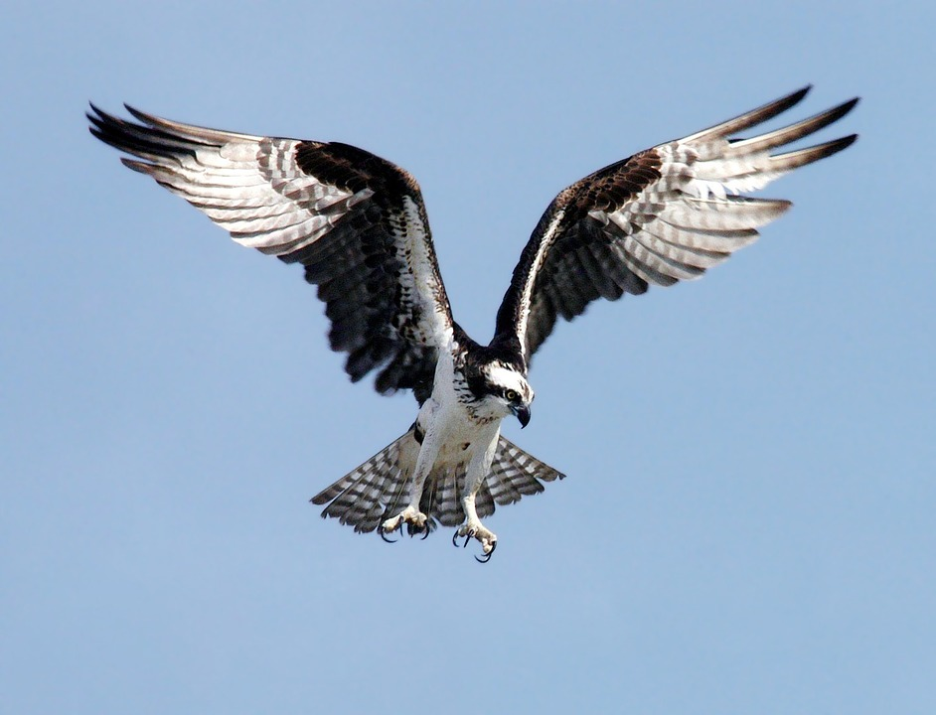
Bird Wings
The shape of a bird’s wings helps it to fly.
The wings are curved on top and flat on bottom.
When a bird flies, air moves slowly across the bottom so there is more air pressure ( slow moving air has more pressure, fast air has less- Bernoulli’s principle). This produces an upward push called lift.
The amount of lift depends on 3 things: (1) the total surface of the wing (2) the speed at which air moves over the wing (3) the angle of the wing.

Slide 6
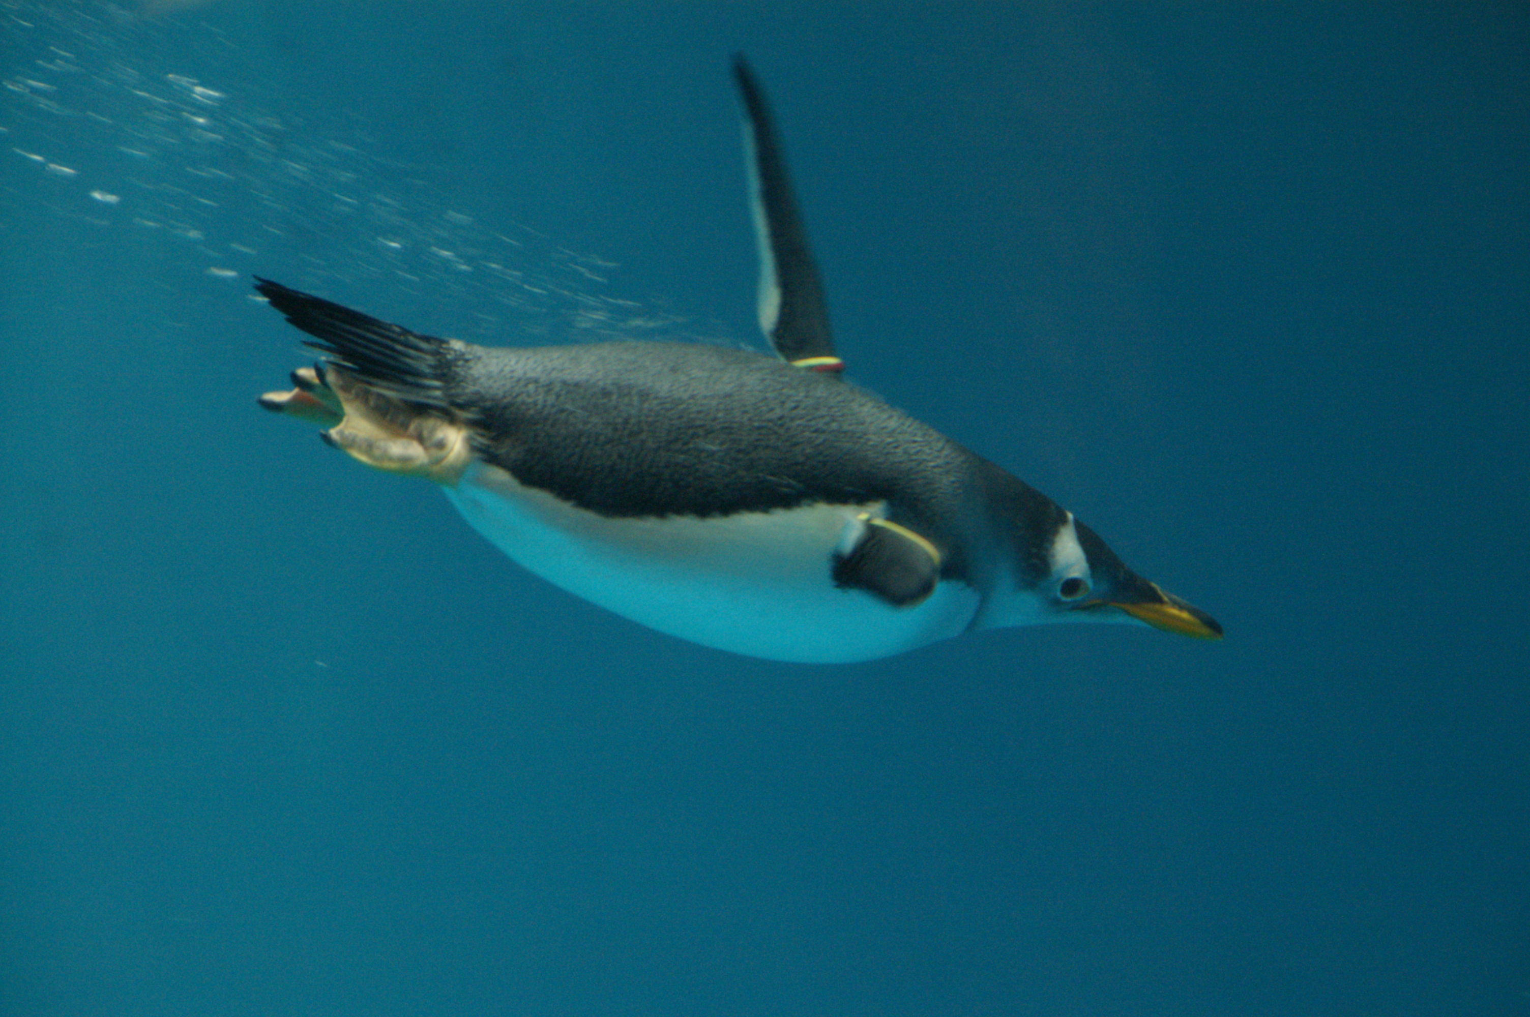
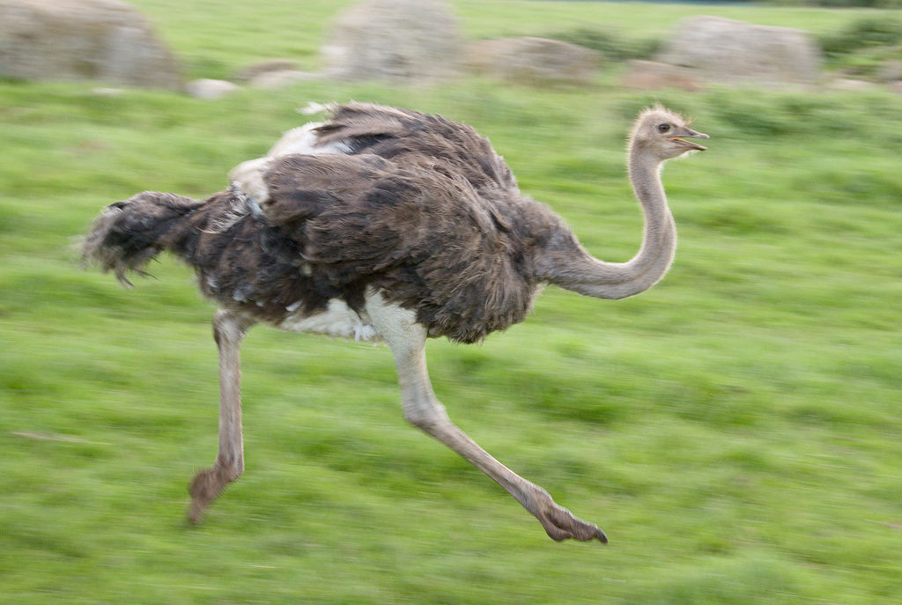
Other uses for wings
Penguins use wings to swim underwater.
Ostriches use wings for courtship.
Ostriches also use their wings to maintain their balance while walking or running.

Slide 7
Bird Characteristics
Because birds use so much energy flying, digestion takes place very quickly.
Birds digest food in less than an hour, humans in contrast take more than a day.
Birds have no teeth, but grind food in a gravel filled organ called a gizzard.
Birds take in oxygen while inhaling and exhaling, which provides more oxygen for flight.
Birds are important for food and raw material, control pests including insects, pollinating flowers, and seed eating birds help control weeds.

Slide 8
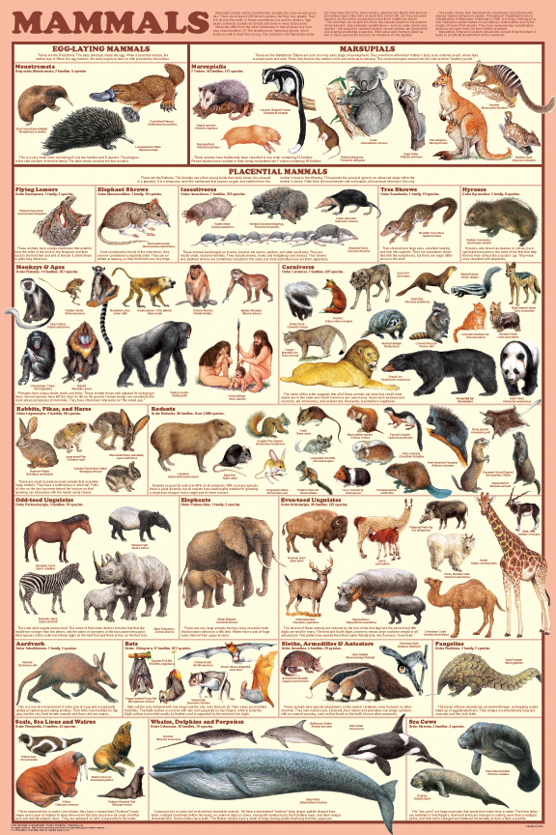
Section 2 : Mammals

Slide 9
Characteristics of Mammals
Mammals are endothermic vertebrates that have hair, produce milk to feed their young, and care for their young.
All mammals have mammary glands
Mammary glands- glands in the female that produce milk for feeding the young.
Almost all mammals have specialized teeth.
Incisors are the front teeth that bite and cut your food.
Canine teeth are used to grip and tear your food.
Premolars and molars are at the back of the mouth to shred, grind, and crush.

Slide 10
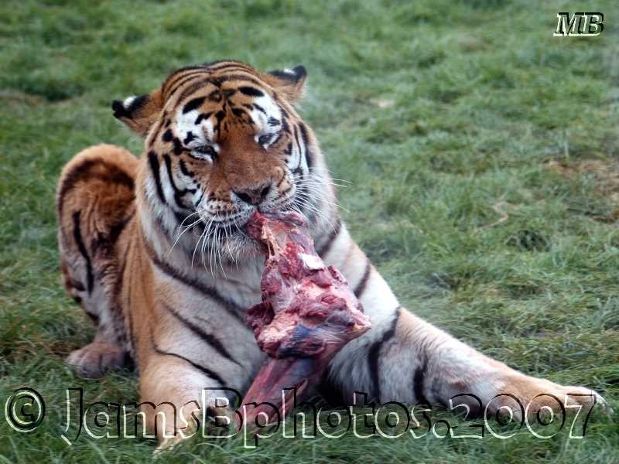
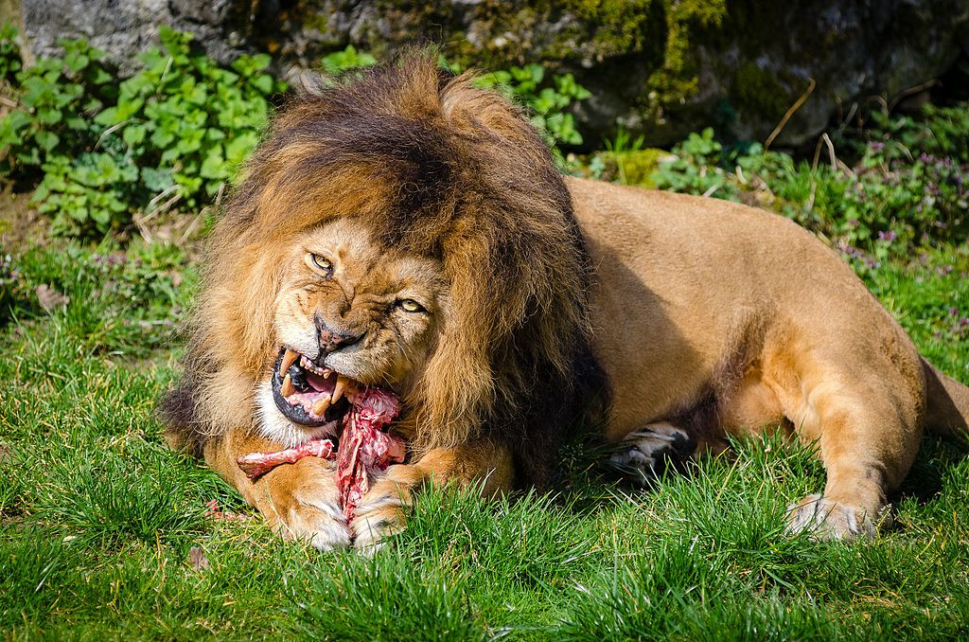
Characteristics of Mammals
Mammals can either be omnivores, carnivores, or herbivores.
Omnivore- eats plants and animals.
Carnivore- eats only animals.
Herbivore - eats only plants.
Animal fur traps air and helps keep the animal warm.
Whiskers near the mouth help them to sense the environment.
A mammals nervous system consists of a brain, spinal cord, and nerves.

Slide 11
Characteristics of Mammals
Digestive systems vary according to the kind of food the animal eats.
Herbivores have a long digestive tract because plants take longer to digest than meat.
All mammals reproduce sexually. Most mammals give birth to live young.
Mammals are classified into 3 groups based on how their young develop.

Slide 12
Characteristics of Mammals
The 3 mammal groups are monotremes, marsupials, and placentals.
Monotremes- are mammals that lay eggs (duck-billed platypus).
Marsupials- give birth to immature young that finishes developing inside the female’s pouch (opossum).
Placentals- embryos completely develop inside the female’s uterus. (humans)
Gestation period- time it takes for the embryo to develop (16 days in hamsters, 650 days in elephants).
Placenta- tissue around the embryo that provides it with oxygen and food.
Umbilical cord- connects embryo to placenta and transports food and oxygen and removes waste.

Slide 13
The End

