Slide 1
Chapter 1 notes
Exploring and classifying Life

Slide 2
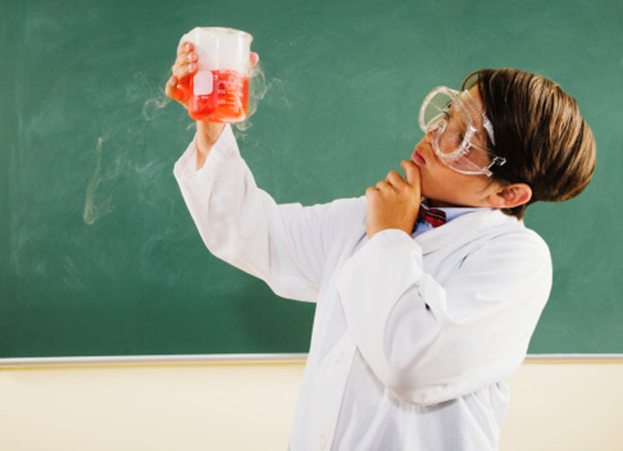
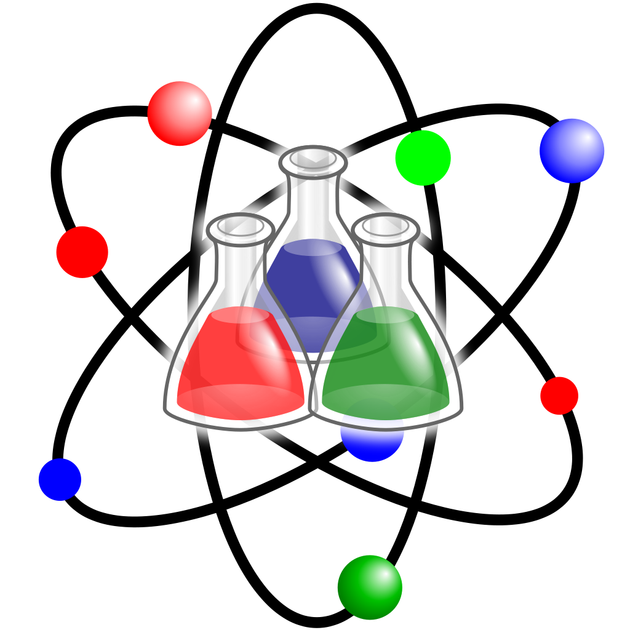
What is Science?
Science is an organized way of studying things or answering questions.
Critical thinking is a process that uses certain skills to solve problems.
Scientific method is an organized way to solve a problem using a series of procedures.
Hypothesis- a prediction that can be tested.

Slide 3
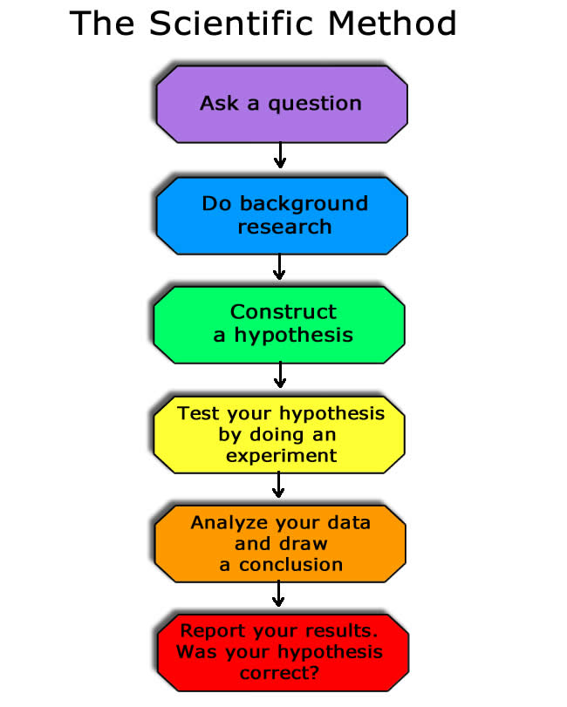
Scientific Method
Research information to help you better understand your science topic.
I wonder what would happen if ……….?
Plan a procedure and follow the step to test your hypothesis.
Make a hypothesis, or educated guess, that you think answers your question.
Communicate your results by presenting your experiment, observations, and conclusions.
Make observations, reflect on your results, and draw conclusions.

Slide 4
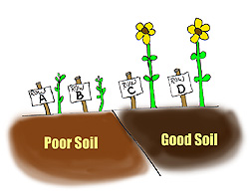
What is Science ?
Control- the standard of comparison in an experiment.
Variable- part of an experiment that can be changed.
Theory- an explanation of things or events based on many observations.
Scientific Law- a statement about how things work in nature that seems to be true all the time.

Slide 5
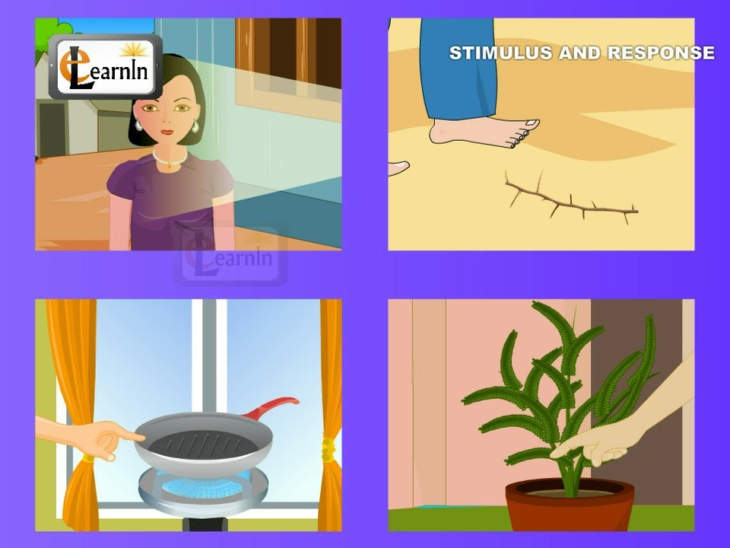
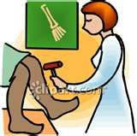
Living Things
Organism- any living thing.
Cell- the smallest unit of an organism that carries on the functions of life.
Stimulus is anything that causes some change in an organism.
The response is the way an organism reacts to a stimulus.
Ex.- Touching a hot pan or stepping on a stick.

Slide 6
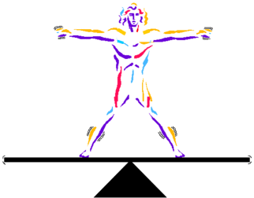
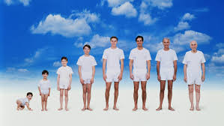
Living Things
Homeostasis- is an organism’s ability to maintain a steady condition. Ex. The human body.
All living things grow and develop. Babies laughing at 4 months of age is an example of development.
Life span- is the length of time an organism can expect to live.
The average life span of a male in the U.S. is 76.
The average life span of a female in the U.S. is around 78.
Most living things are more than 50% water.

Slide 7
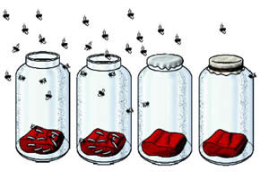
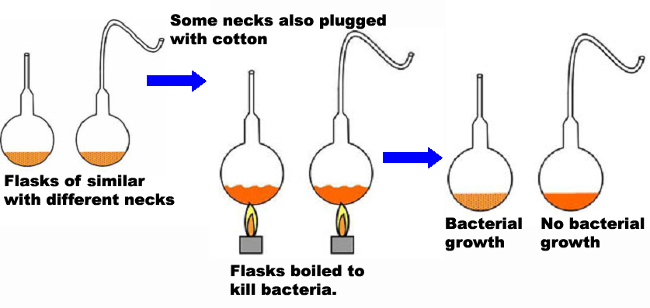
Where does life come from?
Spontaneous generation- the idea that living things come from nonliving things
Biogenesis- the theory that living things come only from living things.
Redi showed that maggots hatched from eggs, not meat.
Louis Pasteur disproved the theory of spontaneous generation.

Slide 8
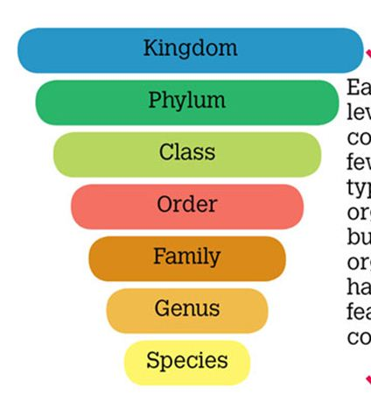
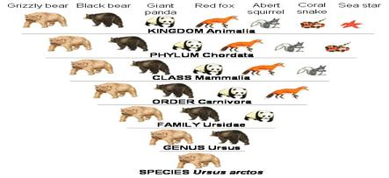
How are living things classified?
Phylogeny- the evolutionary history of an organism.
Kingdom- the first and largest category of organisms.
Binomial nomenclature- two word naming system used by scientists to name organisms.
Genus- first word of an organism’s scientific name.
Species- can mate and produce fertile offspring.

Slide 9
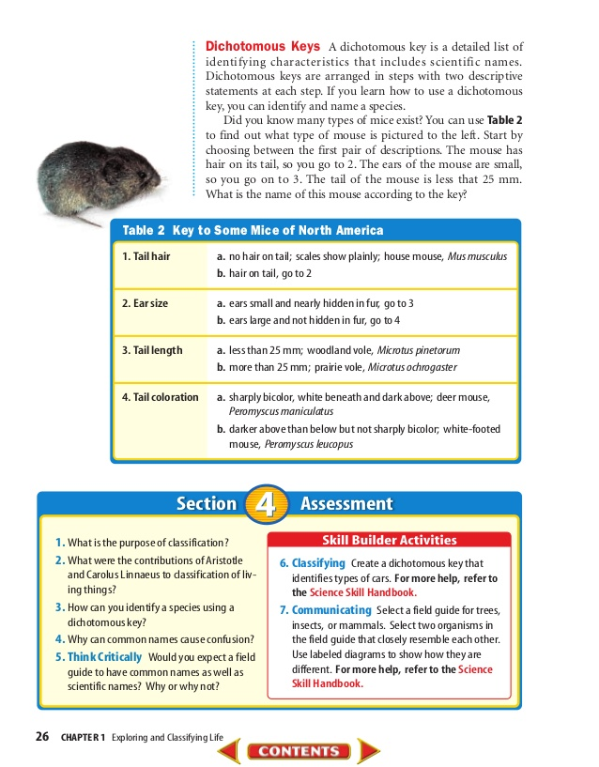
Dichotomous Key

